Slide 1
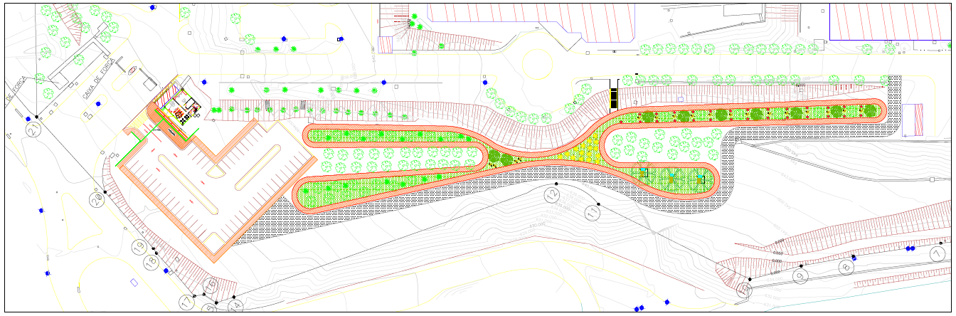
10. Construction Plan
Walking Track – Grupo Infra
INFRA
Length –750m
1
Visitors parking
50 spaces
2
Walking Track
750 m
3
Maintenance area

Slide 2
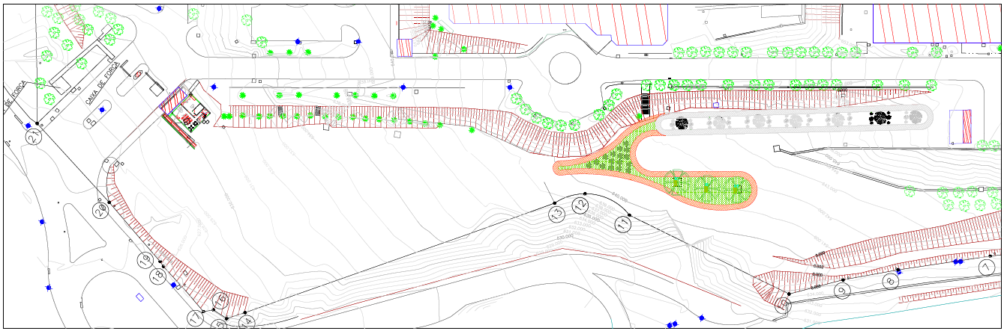
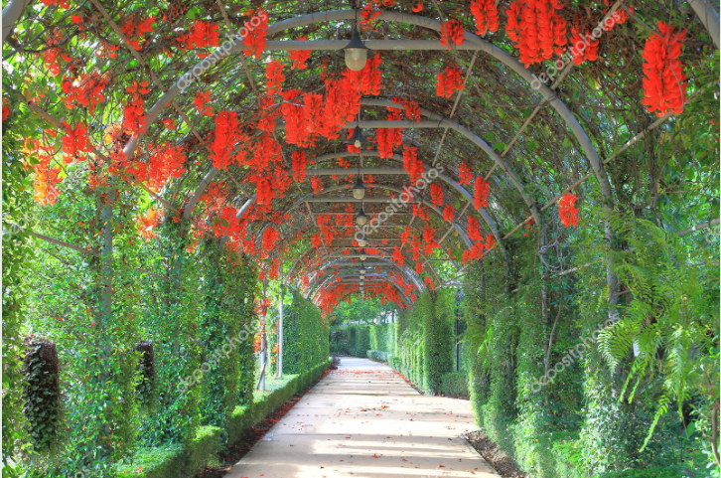
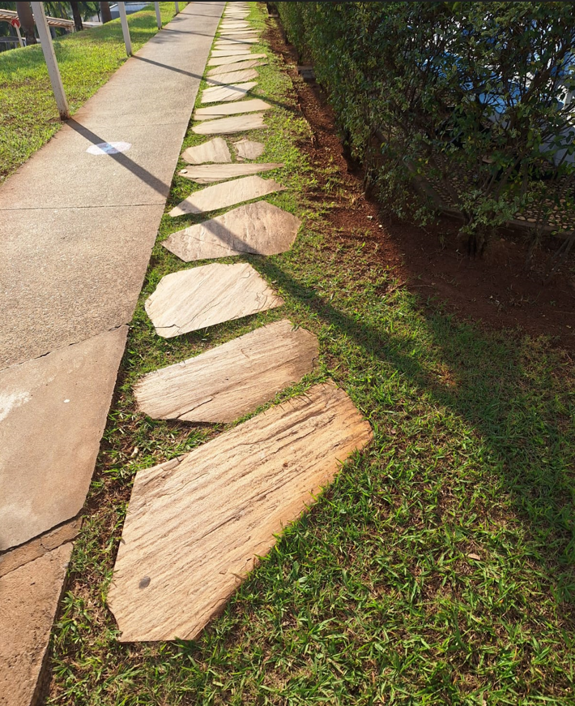
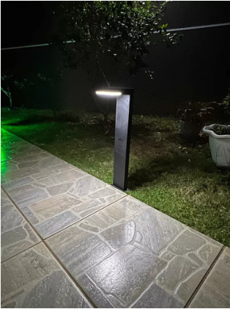
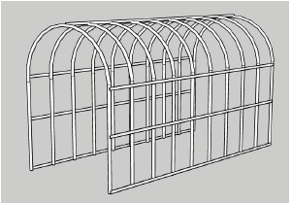
10. Construction Plan
Walking Track – Grupo Infra
INFRA
STEP 01 – 191m Walking Track -
CLIMBING PLANT
NATURAL STONES AND GRASS
SOLAR GROUND LIGHTING
GALVANIZED METAL ARC

